Slide 1
Miss Mrs. Beauty Icon India 2019
A Pageant for Women Empowerment

Slide 2
About Aarna Foundation
NGO dedicated for women’s empowerment and working tirelessly last two years.
100% assurance to meet clients, sponsors, audience, and participants expectations.
Social Events
Summer Camps for underprivileged girls – Free Books, Clothes, Food, beauty courses
Diwali celebration in old-age home
Events we work on – Fashion shows, Beauty Pageants, social events

Slide 3
A message from Aarna Foundation
We would like to introduce you to the second season of “Miss/Mrs. Beauty Icon 2019” to be held in month of June, 2019 .
This event is about Women Empowerment and praising “Talent and Beauty.”
The “Miss/Mrs. Beauty Icon 2019” team aims to bring the strength and beauty of the women of today.
We strongly feel to generate awareness about the social issue and to highlight the problem of Acid attacks. We are trying beyond merely spreading awareness, we seek to motivate people to take up issues
The fund raised from the event will be donated to “Aarna Foundation” and NGO that works for Women Empowerment
We would like to thank you for giving us you precious time and we look forward for your response.

Slide 4
About “Miss & Mrs. Beauty Icon India 2019”
“Miss/ Mrs. Beauty Icon India 2019”. This is not only contest, this is right way to entering in fashion world for women.
A beauty pageant for married and non-married women’s that celebrates and admires the compassion and achievements of a wife, mother, sister and complete women from all walks of life with natural beauty and intelligence.
“Miss/Mrs. Beauty Icon India 2019” explores and identifies such women who exemplify Beauty, Talent, Intelligence, Courage, and Compassion.
Also, we strongly feel to generate awareness about social issue and to highlight the problem of literacy in underprivileged girls. We are trying beyond merely spreading awareness, we seek to motivate people to take up

Slide 5
Our Mission
“Miss/Mrs. Beauty Icon India 2019” aims to create and empower role models who will serve as ambassador to Charity, enrich the perception to beauty, and enhance a new strength, energy and spirit of advancement of women.
This is the pageant which will provide a platform for women where they should get an opportunity to make a difference to the world
Through this pageant women from all over India will gat a chance to enter in fashion world, show casing own skills, Ability, Excellence, and Courage

Slide 7
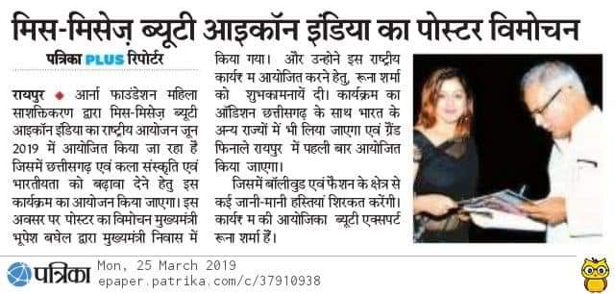
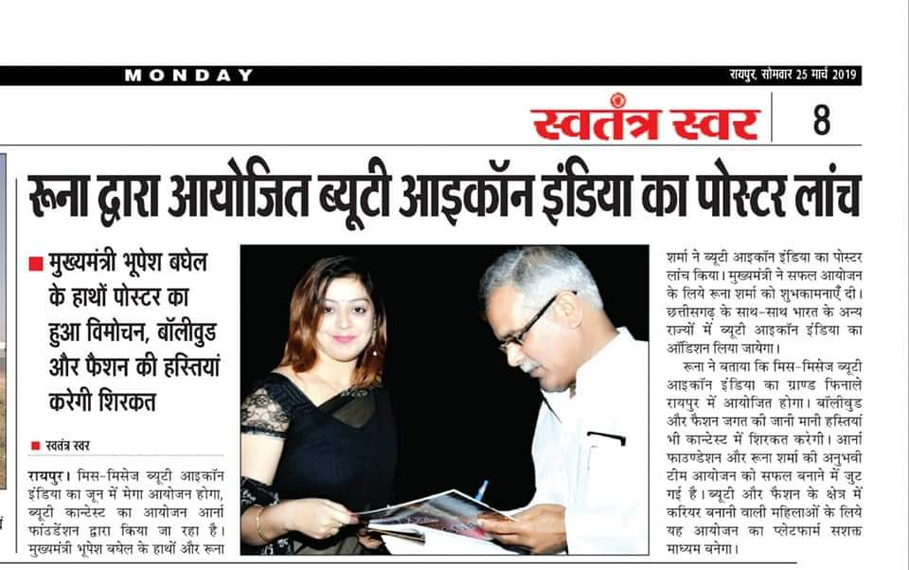
Glance

Slide 8
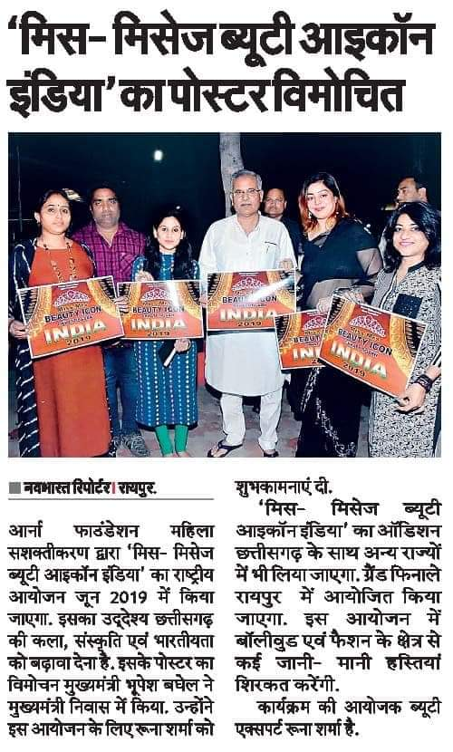
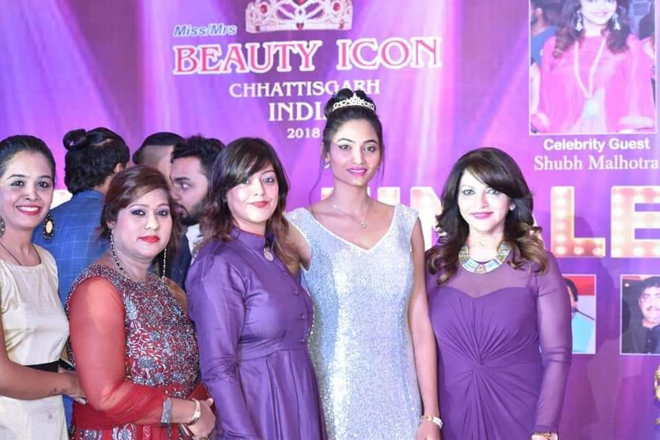

Slide 9
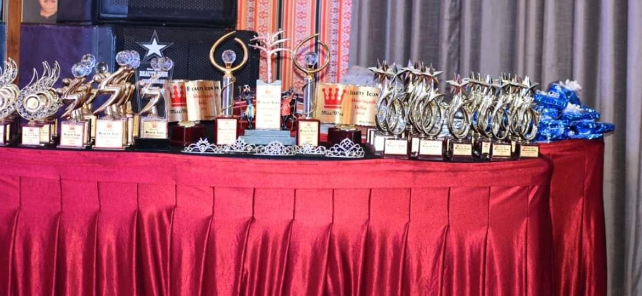
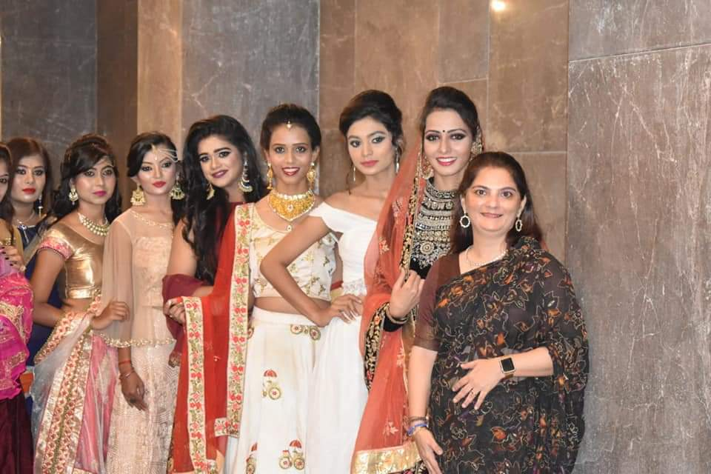
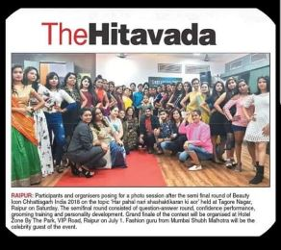
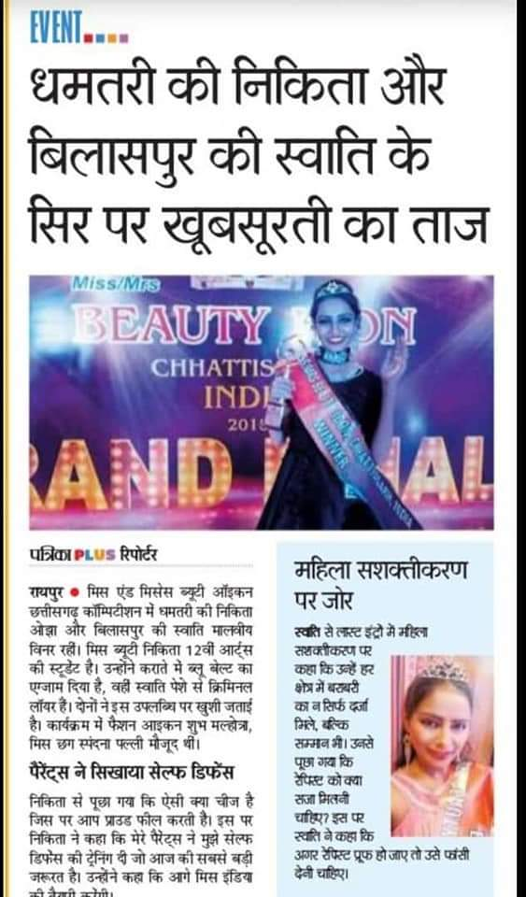
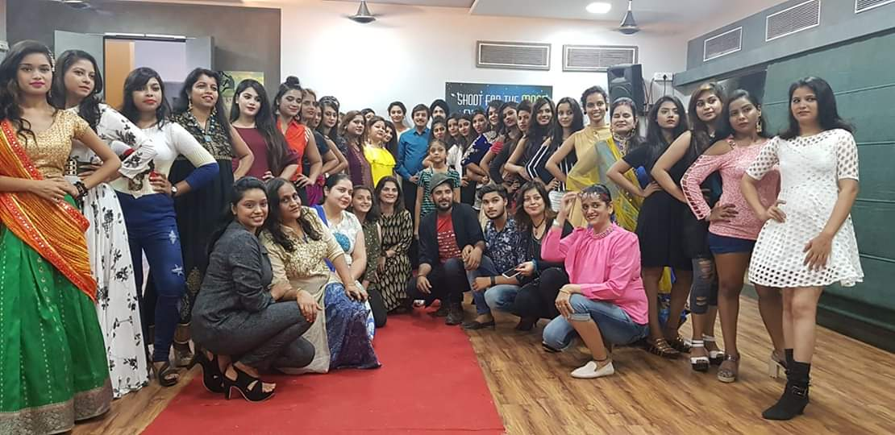
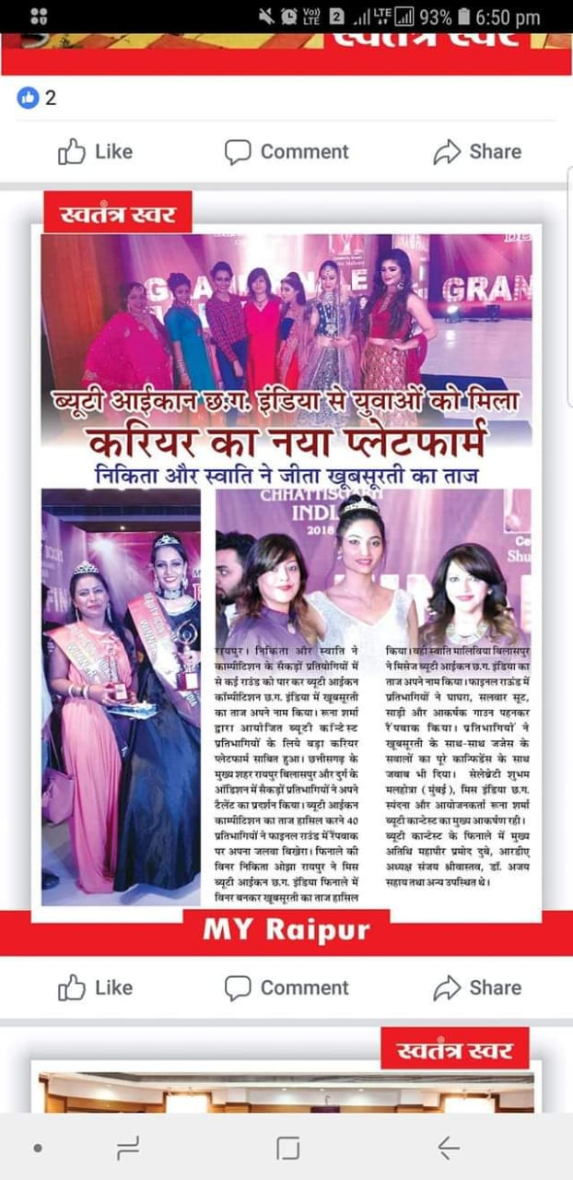

Slide 11
Event Promotion
Social Media
Brand Promotion
Outdoor Promotion

Slide 12
Previous Sponsors
Presented by Aarna Foundation

Slide 14
Miss Mrs. Beauty Icon India 2019
Presented by Aarna Foundation

Slide 15
Miss Mrs. Beauty Icon India 2019
Presented by Aarna Foundation

Slide 16
Miss Mrs. Beauty Icon India 2019
Presented by Aarna Foundation

